Slide 1
RadiGist – LLM Based Impression Prediction Solution
Group member:
Junru (Aeris) Li, Yue Zhang, Kairan Zhong, Xiran Li

Slide 2
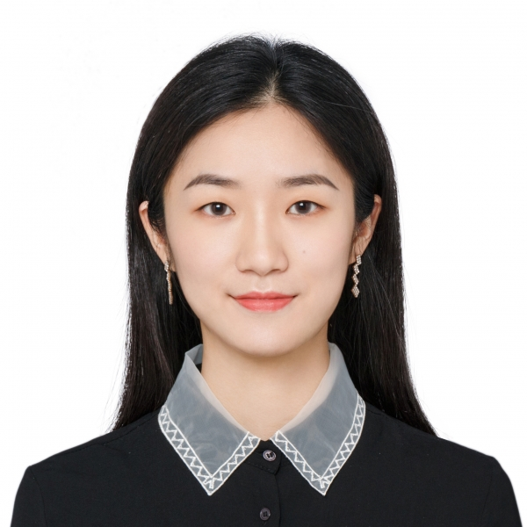

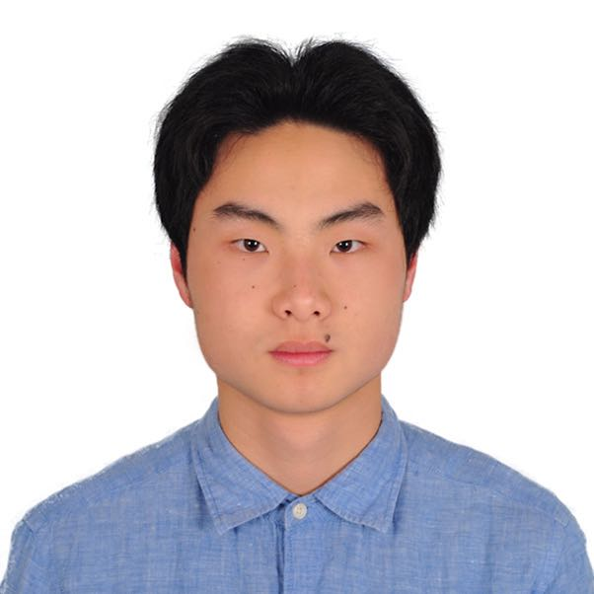
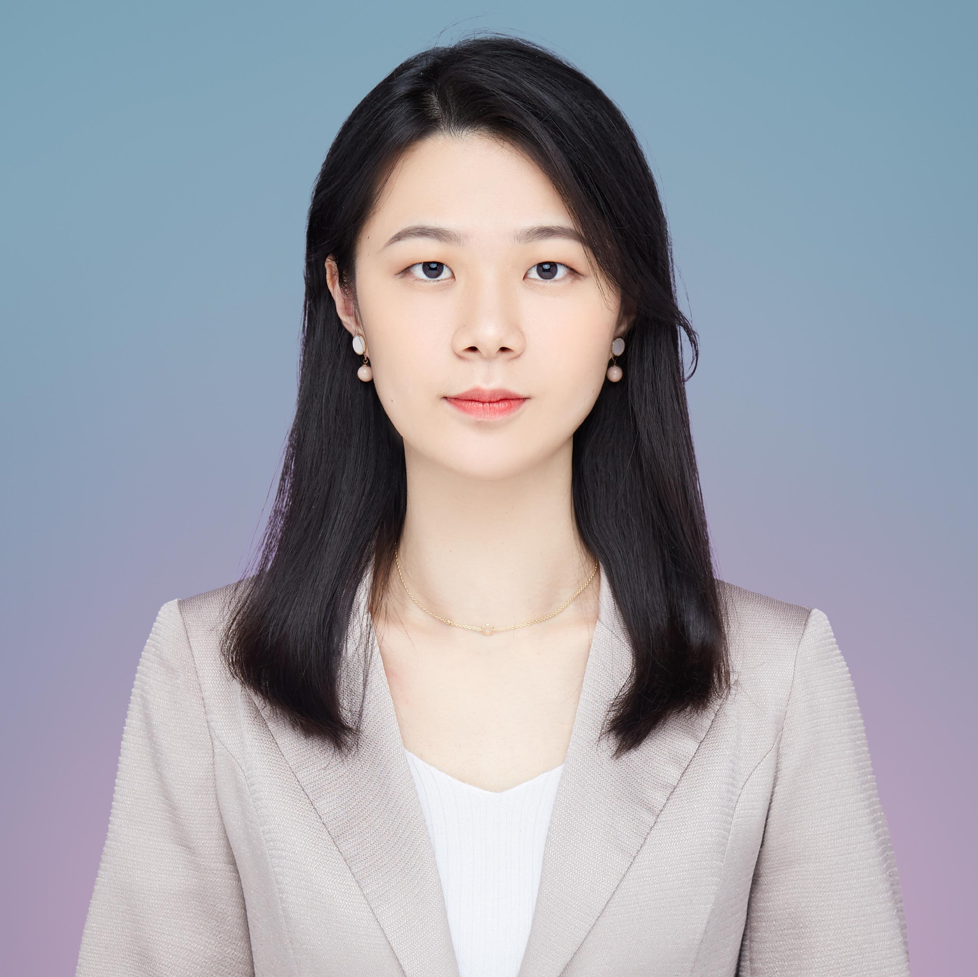
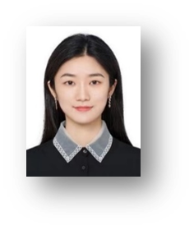
Team members introduction
Junru (Aeris) Li
• Studies: ADSP in the University of Chicago
• Work experience: Data Analytics & Strategy
Yue Zhang
• Studies: ADSP in the University of Chicago
• Work experience: Data Science & Analytics
Kairan Zhong
• Studies: ADSP in the University of Chicago
• Work experience: Data Analytics
Xiran Li
• Studies: ADSP in the University of Chicago
• Work experience: Retail & Finance

Slide 3

Agenda
1
Introduction
P4-P9
2
Technical Background
P10-P12
3
Framework
P13-P17
4
Findings
P18-P21
5
Future Improvements
P22-P23

Slide 4
Introduction
/01
Business Background
Business Values
Problem Statement

Slide 5
Physicians spend more time on report summaries than patient treatment
The existing healthcare technology infrastructure struggles with processing unstructured text, leading to several critical challenges:
Physician burnout
Lower-quality or even errors in care delivery
Inefficiencies in healthcare workflows
Source: American Medical Association

Slide 6
RadiGist provides benefits from several aspects
Business Values
Reduction of
Physician Burnout
High-quality
Patient Care
Precision and
Efficiency
Readability and
Usability
Mitigate physician mental fatigue from repetitive tasks, reducing their burnout
Minimize patient misdiagnosis caused by errors in medical report interpretation
Generate accurate and concise impressions in nearly real time
Create a user-friendly interface

Slide 7

Inference Analytics advances healthcare with AI-driven medical language processing support
Company Background
01
Core Business
02
A Chicago-based healthcare Artificial Intelligence (AI) startup that focuses on medical language processing
AI platform providing real-time clinical decision support to radiologists
03
Latest Project
Developing an AI-based solution to generate "impressions" within the radiology report
Our team will use advanced predictive models, LLMs, to create a deployable solution that generates real-time impressions from clinical information and findings

Slide 8
Our value proposition empowers the client to capture a larger market share
TAM
Total Addressable Market: GenAI
2023 Market size of $56.8 billion; CAGR at 42%
Serviceable Available Market: LLMs
2023 Market size of $12.75 billion; CAGR[1] at 21.4%
SAM
SOM
Serviceable Obtainable Market: LLMs in healthcare industry
2023 Market size of $0.5 billion
Source: Bloomberg, Allied Market Research
With the empowerment of our RadiGist product,
Inference Analytics can enhance its competitive edge and meet market demands more effectively
[1]: Compound annual growth rate

Slide 9
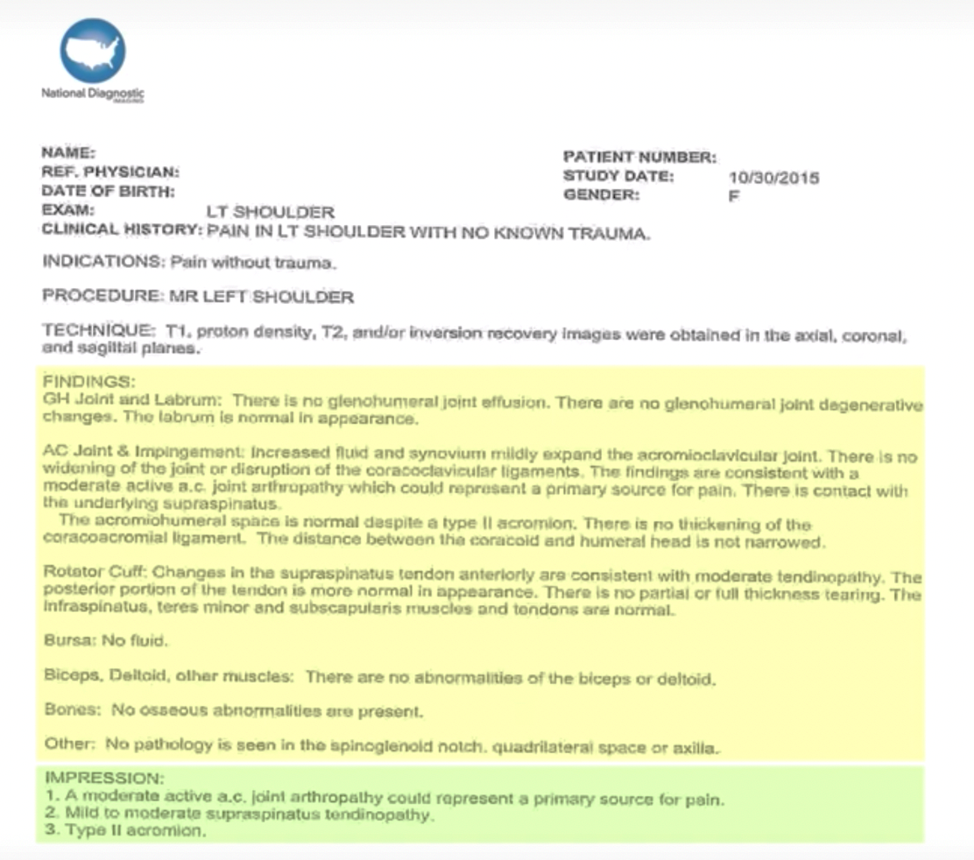
RadiGist is focused on generating impressions from unstructured narratives within radiology reports
Clinical information + Findings => Impressions
Clinical information: The patient’s clinical history
Technique: Describes how the exam was done
Findings: Descriptive observations from the radiologist
Impressions: Interpretation and conclusion about the exam

Slide 10
Technical Background
/02

Slide 11
Text Summarization: Our project is an abstractive summarization task
Next Token Prediction
Large Language Models
Understanding these technical concepts is key to grasping our product
Abstractive Summarization
Generate new sentences while keeping the essence of the original text intact.
Extractive Summarization
Select and combine existing sentences from a text to create a summary.
VS.
Definition:
Predicts the most probable subsequent token based on the sequence of tokens that have already been processed.
How it works:
1. Sample a token from ~ p(next token | previous tokens)
2. Append the token to the input
3. Run the new input through the transformer ...
By employing next-token prediction, Large Language Models (LLMs) can generate coherent and contextually relevant text, one token at a time, based on the probabilities learned during their training phase.
A massive number of parameters which are learned from vast datasets of text during training.

Slide 12
Instruction Tuning is a subset of Fine-Tuning
Focused on alignment with humans
All possible Fine-Tuning
Concerned with following “instructions” like a human would
Augments input-output examples with instructions, which enables instruction-tuned models to generalize more easily to new tasks
Instruction-Tuning
Example
### Instruction:
### Input:
### Output:

Slide 13
Framework
/03
Workflow
Data
Models

Slide 14
What is the workflow of RadiGist
Data
Models
Evaluation
Instruction Tuning
### Instruction:
“Generate impression based on….”
### Input:
Clinical Information + Findings
### Output:
Impression
LLM Base Model
(Merged with
LoRA Adaptor)
Rouge Score:
Rouge-1
Rouge-2
Rouge-L

Slide 15

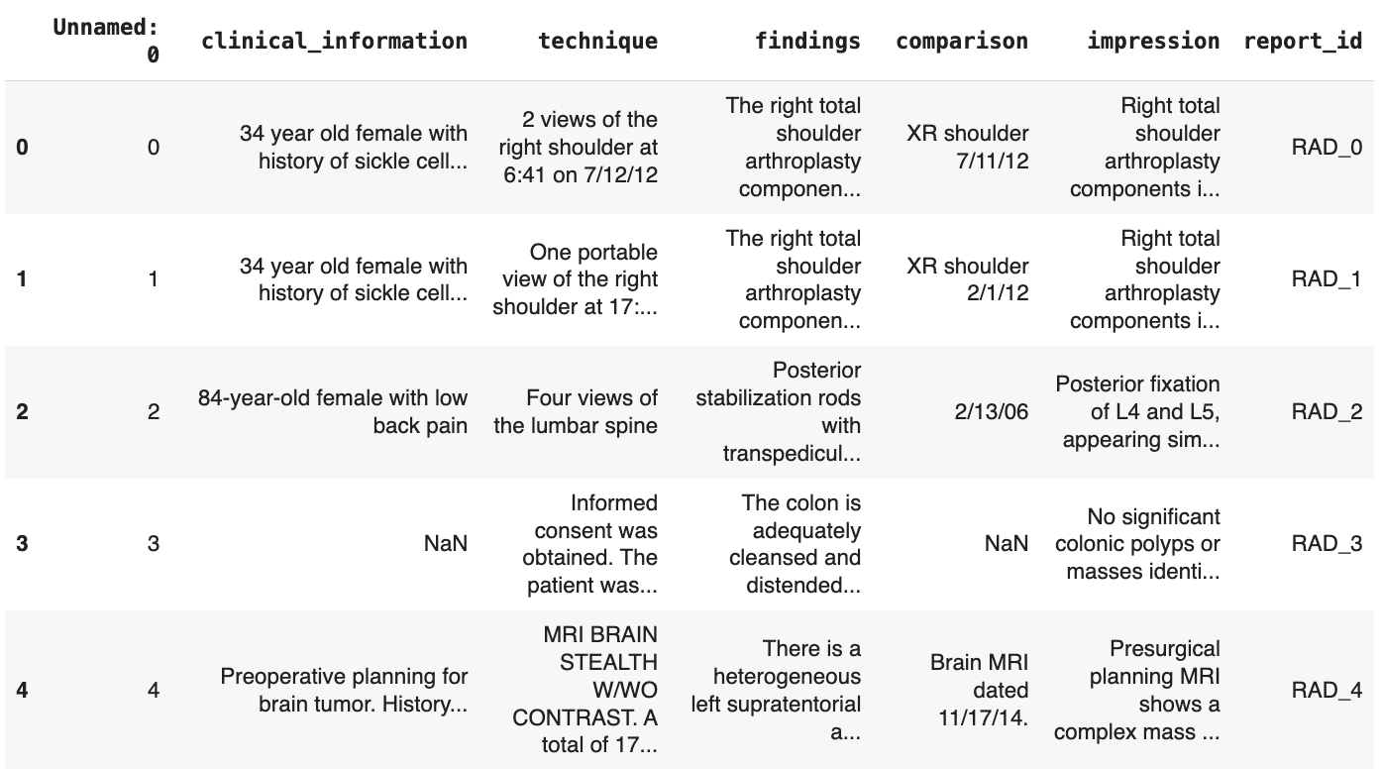
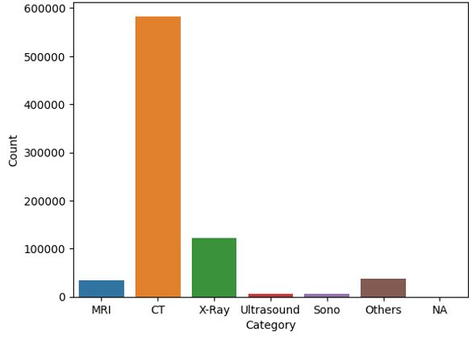
Our data is textual, well-organized, and covers multiple modalities
Data Source: 1M de-identified radiology reports from University of Chicago Medicine
Data Overview:
Categorize data
into different modalities
Choose MRI for modeling considering the data size

Slide 16
Our model selection process is based on several criteria
Selection Criteria | Meta AI |  | Open AI |  | Mistral AI
 | Llama | Llama 2 | GPT3 | GPT4 | Mistral
Open-Source Availability | Open-source, accessible through API | Open source, available for free and for commercial use | Not open-source | Not open-source | Open-source and community-focused
Manageable Model Size | Manageable; there are versions with 7B and 13B parameters, as well as other fine-tuned versions | Manageable; there are versions with 7B and 13B parameters, as well as other fine-tuned versions | Impractical, with more than 175B parameters. | Impractical, with more parameters than GPT3 (precise size not revealed) | Manageable parameter sizes (7.3 billion parameters)
Proven Performance | LLaMA-13B outperforms GPT-3 (175B) on most benchmark | Strong improvements over prior LLMs across diverse benchmarks; Demonstrates factual accuracy on par with GPT4 and superior to GPT3.5 when summarizing text.[1] | Performs well in a variety of language tasks like abstract summarization | Better performance compare with the GPT previous version | Beats Llama 2 13B on all benchmarks and Llama 1 34B on many benchmarks [2]
Use Case | Typically include text summarization, language translation, and basic question-answering | More enhanced capabilities, more suitable for applications that demand a higher level of language comprehension | More specialized in creating human-like text and even performing programming tasks, known for its generation capability | Excels in more complex and nuanced language tasks like intricate content creation, complex problem-solving, and advanced conversational AI applications with greater accuracy and nuance | Supports a variety of use cases, such as text summarization, classification, text completion, and code completion
2020
2021
2022
2023
2020.9 GPT-3
2022.3 GPT-3.5
2023.2 Llama
2023.3 GPT-4
2023.7 Llama 2
2023.9 Mistral
[1] https://promptengineering.org/how-does-llama-2-compare-to-gpt-and-other-ai-language-models/
[2] https://mistral.ai/news/announcing-mistral-7b/

Slide 17
Five LLMs are selected as our base models
Selection of models is based on:
Open-Source Availability
Manageable Model Size
Proven Performance
Use Case
Large Language Models
Fine-Tuned Versions
Alpaca-7b
Medalpaca-7b
(specifically fine-tuned on medical data)
Llama
Meta AI
Base Model
Llama 2.0
Llama2-7b
Llama2-13b
Mistral AI
Mistral
Mistral 7b
* Alpaca-7b: Alpaca 7B is a fine-tuned version of the seven billion-parameter LLaMA language model from Meta.
* Medalpaca-7b: MedAlpaca expands upon both Stanford Alpaca and AlpacaLoRA to offer an advanced suite of large language models specifically fine-tuned for medical question-answering and dialogue applications.

Slide 18
Findings
/04
ROUGE Metrics Introduction
ROUGE Metrics Comparison
Demo

Slide 19
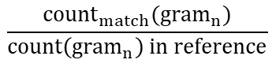
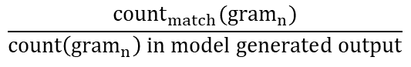
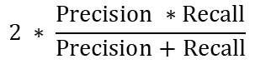
We use ROUGE scores as our evaluation metrics
ROUGE (Recall-Oriented Understudy for Gisting Evaluation)
ROUGE-N: measures the number of matching “n-grams” between our model-generated text and a “reference”
ROUGE-L: measures the longest common subsequence (LCS) between our model output and reference
n-grams
Original: “the fox jumps”
Unigrams: [‘the’, ‘fox’, ‘jumps’]
Bigrams: [‘the fox’, ‘fox jumps’]
Trigrams: [‘the fox jumps’]
Taking ROUGE-1 as an example:
Model
“the hello a cat dog fox jumps”
reference text:
“the fox jumps” [‘the’, ‘fox’, ‘jumps’]

Slide 20
We compare our models to the baseline result
System | ROUGE-1 | ROUGE-2 | ROUGE-L
PG ⊕ BERT (Baseline Result) | 47.17 | 32.89 | 45.91
Alpaca-7b | 45.63 | 27.34 | 38.08
Medalpaca-7b | 50.47 | 31.02 | 42.10
Llama-7b | 46.75 | 28.02 | 39.07
Llama-13b | 44.98 | 26.54 | 38.53
Mistral-7b | 56.42 | 40.11 | 48.66
Specification
Modality: MRI
Data Size: 33,894
Training : Test = 0.8 : 0.2
The fine-tuned Mistral-7b model emerged as the top performer, surpassing other models and baseline results

Slide 21
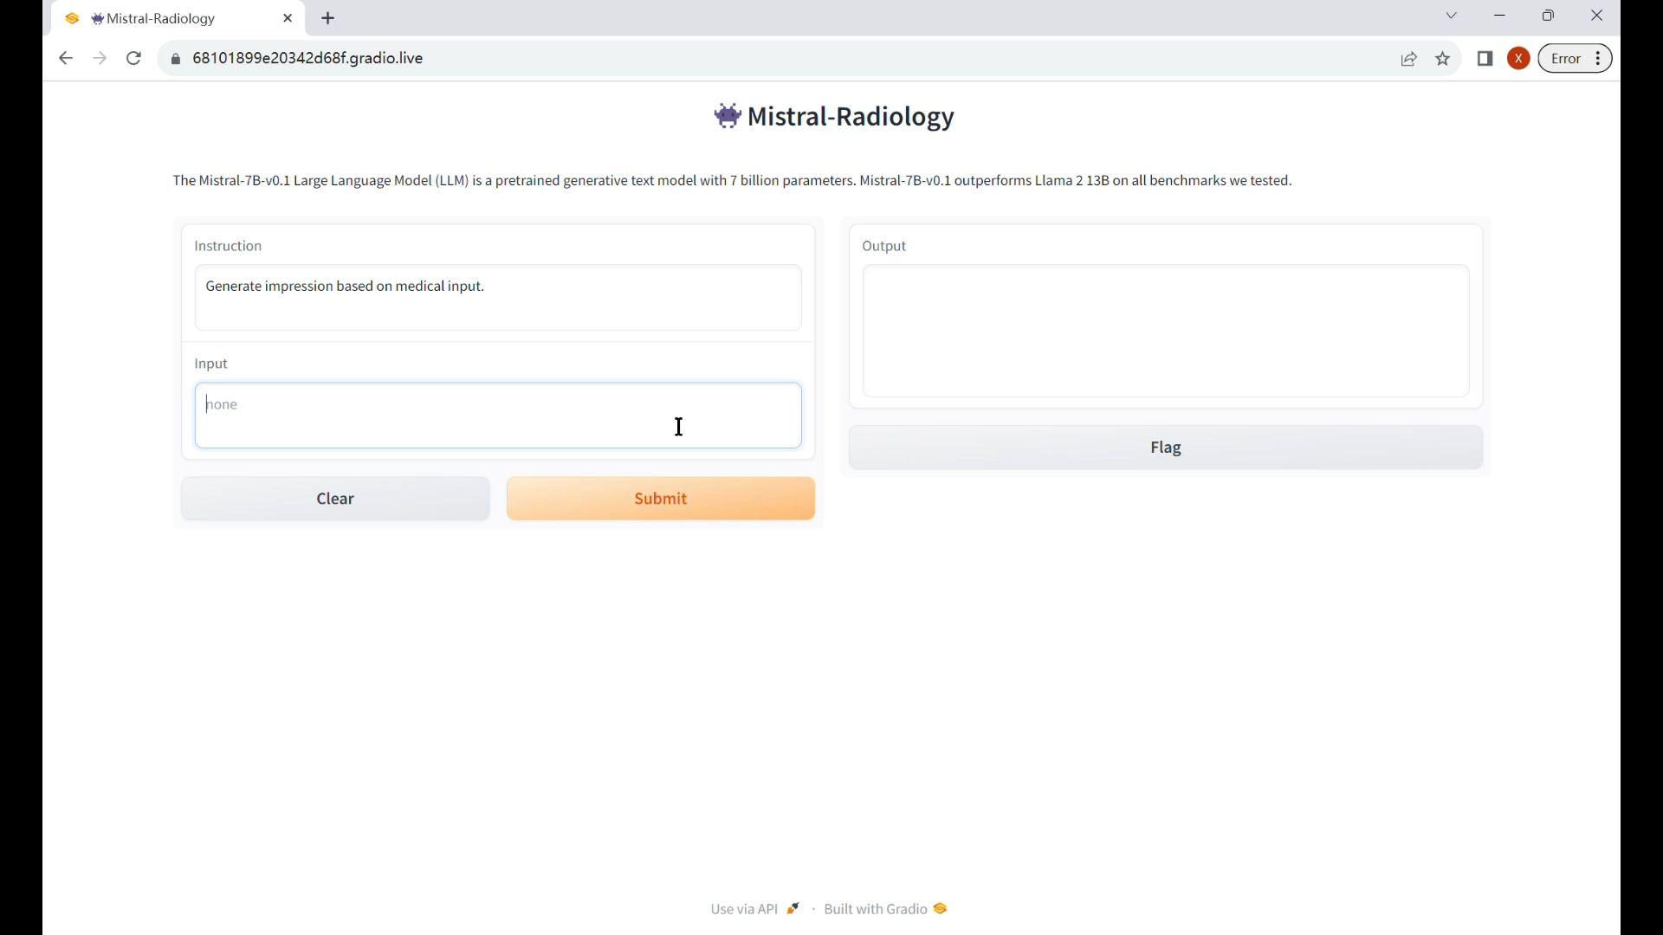
Our final deliverable is a user-friendly interface
Successfully deployed our models using Gradio to generate real-time impressions

Slide 22
Future Improvements
/05

Slide 23


Future improvements could focus on refining evaluation methods and expanding generalizability
Evaluation Method
Generalizability
Strategy: Include judgements from Subject Matter Experts (SMEs) in radiology
Strategy: Test on other data (e.g., Indiana University data) to enhance generalization

Slide 24



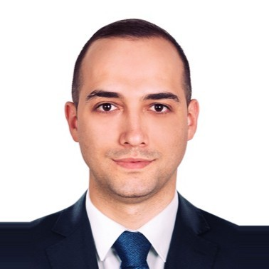

Acknowledgement
Utku Pamuksuz
Chief Data Scientist @ Inference Analytics,
Capstone Advisor,
Capstone Instructor
Benan Akca
Senior Data Scientist @ Inference Analytics
Roger Moore
Capstone Instructor

Slide 25
Thanks!
Junru (Aeris) Li, Yue Zhang, Kairan Zhong, Xiran Li
11/28/2023

Slide 26
Reference and appendix content
Reference
P27-P28
Appendix 1: Project timeline
P29
Appendix 2: Literature review summary
P30
Appendix 3: Popular LLMs existing in the market
P31
Appendix 4: ROUGE Score
P32
Appendix 5: Findings
P33-35
Appendix 6: Factual Correctness
P36
Appendix 7: Challenges & methods to overcome
P37
Appendix 8: Data bias and ethics discussion
P38

Slide 27
References
[1] Touvron, H., Lavril, T., Izacard, G., Martinet, X., Lachaux, M. A., Lacroix, T., ... & Lample, G. (2023). Llama: Open and efficient foundation language models. arXiv preprint arXiv:2302.13971.
[2] Gundogdu, B., Pamuksuz, U., Chung, J. H., Telleria, J. M., Liu, P., Khan, F., & Chang, P. J. (2021). Customized impression prediction from radiology reports using bert and lstms. IEEE Transactions on Artificial Intelligence.
[3] Lee, M., Srivastava, M., Hardy, A., Thickstun, J., Durmus, E., Paranjape, A., ... & Liang, P. (2022). Evaluating Human-Language Model Interaction. arXiv preprint arXiv:2212.09746..
[4] Zhang, A., Xing, L., Zou, J. et al. Shifting machine learning for healthcare from development to deployment and from models to data. Nat. Biomed. Eng 6, 1330–1345 (2022). https://doi.org/10.1038/s41551-022-00898-y
[5] Sezgin E, Sirrianni J, Linwood S. Operationalizing and Implementing Pretrained, Large Artificial Intelligence Linguistic Models in the US Health Care System: Outlook of Generative Pretrained Transformer 3 (GPT-3) as a Service Model. JMIR Med Inform 2022;10(2):e32875
https://medinform.jmir.org/2022/2/e32875
[6] Edjinedja, L., Omar, E., Barakat, O., Desmettre, T., & Marx, T. (2023). LEVERAGE CHATGPT AS TOOL FOR DATA AUGMENTATION FOR SUPERVISED MACHINE LEARNING TASKS IN HEALTHCARE NATURAL LANGUAGE PROCESSING.
[7] Cascella, M., Montomoli, J., Bellini, V., & Bignami, E. (2023). Evaluating the feasibility of ChatGPT in healthcare: an analysis of multiple clinical and research scenarios. Journal of Medical Systems, 47(1), 1-5.

Slide 28
References (cont.)
[8] Liu, Z., Yu, X., Zhang, L., Wu, Z., Cao, C., Dai, H., ... & Li, X. (2023). Deid-gpt: Zero-shot medical text de-identification by gpt-4. arXiv preprint arXiv:2303.11032.
[9] M Lafortune, G Breton, and JL Baudouin, “The radiological report: what is useful for the referring physician?,” Canadian Association of Radiologists journal= Journal l’Association canadienne des radiologistes, vol. 39, no. 2, pp. 140, 1988.
[10] Korngiebel, D.M., Mooney, S.D. Considering the possibilities and pitfalls of Generative Pre-trained Transformer 3 (GPT-3) in healthcare delivery. npj Digit. Med. 4, 93 (2021). https://doi.org/10.1038/s41746-021-00464-x
[11] Puspitaningrum, D. (2022). A Survey of Recent Abstract Summarization Techniques. In: Yang, XS., Sherratt, S., Dey, N., Joshi, A. (eds) Proceedings of Sixth International Congress on Information and Communication Technology. Lecture Notes in Networks and Systems, vol 217. Springer, Singapore. https://doi.org/10.1007/978-981-16-2102-4_71
[12] Zhaopu Teng. Abstractive summarization of COVID-19 with transfer text-to-text transformer. ACE (2023) Vol. 2: 232-238. DOI: 10.54254/2755-2721/2/20220520.
[13] Vo, T. A novel semantic-enhanced generative adversarial network for abstractive text summarization. Soft Comput (2023). https://doi.org/10.1007/s00500-023-07890-x
[14] Sinsky C, Colligan L, Li L, Prgomet M, Reynolds S, Goeders L, Westbrook J, Tutty M, Blike G. Allocation of Physician Time in Ambulatory Practice: A Time and Motion Study in 4 Specialties. Ann Intern Med. 2016 Dec 6;165(11):753-760. doi: 10.7326/M16-0961. Epub 2016 Sep 6. PMID: 27595430.

Slide 29
Appendix 1: Project timeline
TIME |  |  |  | Fall |  |  |  |  |  |  |  |  |  | Project End
Phase |  | PROJECT WEEK: |  | 1 | 2 | 3 | 4 | 5 | 6 | 7 | 8 | 9 | 10
1 |  | Research Design | - Initial Proposal
 |  |  | - Business Problem
2 |  | Implementation | - final Proposal
 |  |  | - Research Proposal Draft
 |  |  | - Literature Review & Methodology
3 |  | Implementation (cont.) | - Research Paper 1st Draft | Research paper 1st draft
 |  |  | - Research Paper 2nd Draft |  |  |  | Research paper 2nd draft
 |  |  | - Research Paper |  |  |  |  |  |  | Final research paper
4 |  | Communication | - Showcase Draft |  |  |  |  | Showcase draft
 |  |  | - Video |  |  |  |  |  |  |  |  | Video
 |  |  | - Showcase |  |  |  |  |  |  |  |  |  | Showcase
5 |  | Client Meeting (iterate) | - Client Meeting |  | meeting | meeting | meeting | meeting | meeting | meeting | meeting | meeting

Slide 30
Appendix 2: Literature review summary
The primary qualities that makes a radiological report useful for referring physicians are clarity, brevity, and clinical correlation. [9]
AI NLP applications can improve work satisfaction for providers and reduce time spent interacting with computer systems, which is a well-documented concern. This could be achieved by routinizing tedious work, such as navigating complex electronic health record (EHR) systems, automating documentation with human review, preparing orders, etc. [10]
For
background:
For
methodology:
Large Language Model (BERT and LSTMs) [2]
Generative Pretrained Models (GPT, T-5, etc.) [7][8]
For model evaluation:
non-interactive (Measuring similarity: e.g., ROUGE metrics; BLEU metrics;...etc.) [2]
interactive (Human-AI Language-based Interaction Evaluation (HALIE)) [3]
Use more recent transformer models for handling larger datasets and enhancing the modeling of clinical text. [4]
Data augmentation :
Deep generative models and federated learning [4]
Text generation using the ChatGPT API. [6]
For model improvement:

Slide 31
Appendix 3: Popular LLMs existing in the market
 | Meta AI |  | Open AI |  | Mistral AI
 | Llama | Llama 2 | GPT3 | GPT4 | Mistral
Introduction | An auto-regressive language model that uses an optimized transformer architecture Comes in a range of parameter sizes (7B, 13B, and 70B …) | Fine-tuned with 40% more data than Llama Double the context length of Llama Involves Reinforcement Learning from Human Deedback (RLHF)* during training Comes in a range of parameter sizes (7B, 13B, and 70B …) | Uses a transformer architecture relies on self-attention mechanisms More than 175 billion parameters (Significantly larger than previous LLM) | More parameters than previous versions Includes more data Longer memory Able to handle multimodal inputs (mixed text or image data) | The only version being published is Mistral-7b (a pre-trained generative text model with 7.3 billion parameters) Different from the competition: open and community-focused instead of proprietary
Use Case | Typically include text summarization, language translation, and basic question-answering Effective for applications where a balance between performance and computational efficiency is needed | More enhanced capabilities, particularly in tasks requiring a deeper understanding of context and complex language structures More suitable for applications that demand a higher level of language comprehension, such as more sophisticated content creation or complex language interpretation | Versatile, with a wide range of applications from creating human-like text to coding: generating creative writing, business communication, technical writing, and even programming tasks. - Ability to generate contextually relevant and coherent text | Excels in more complex and nuanced language tasks like intricate content creation, complex problem-solving, and advanced conversational AI applications with greater accuracy and nuance Valuable in scenarios where deep understanding and sophisticated responses are required | Designed for specialized applications, often in specific industries like healthcare, finance, or legal It can provide detailed analysis and generate industry-specific content
*Reinforcement learning from human feedback (RLHF): incorporating human feedback into the learning process, allowing them to better align their outputs with human expectations and preferences.
Notes:
Krispy Score: 27

Slide 32
Appendix 4: ROUGE Score
ROUGE
ROUGE (Recall-Oriented Understudy for Gisting Evaluation) is a commonly used evaluation metric in NLP to assess the quality of generated text. It compares a generated summary to one or more reference summaries.
ROUGE-1 evaluates the overlap of unigrams between the generated impressions and reference.
ROUGE-2 extends this assessment to bigrams, shedding light on the fluency and coherence of the generated text.
ROUGE-L quantifies the longest common subsequence, which is crucial in capturing the essence and contextual accuracy of the reports.
ROUGE-Lsum applies the ROUGE-L calculation method at the sentence level and then aggregates all the results for the final score.
Different Types
Taking ROUGE-1 as an example:
ROUGE-1 recall = Num word matches / Num words in reference
ROUGE-1 precision = Num word matches / Num words in generated summary
ROUGE-1 F1-score = 2 * (precision * recall) / (precision + recall)
Precision, Recall and F1-score in ROUGE Score

Slide 33
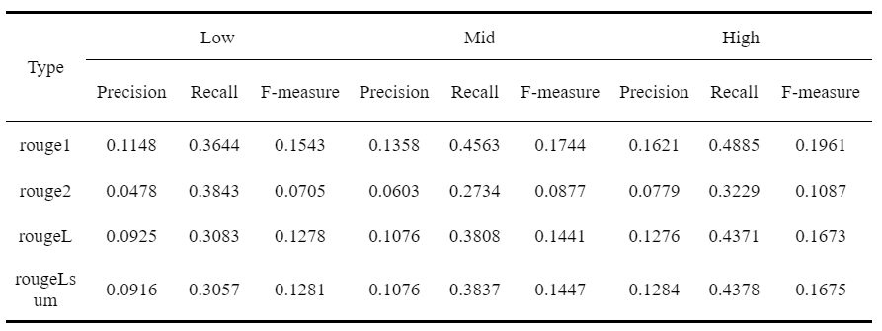
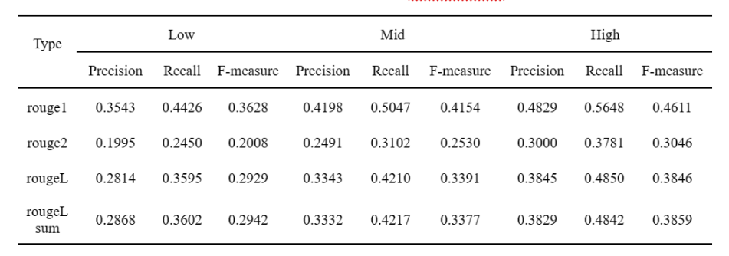
Appendix 5: Findings
Performance Comparison
Alpaca-7b
Medalpaca7b

Slide 34
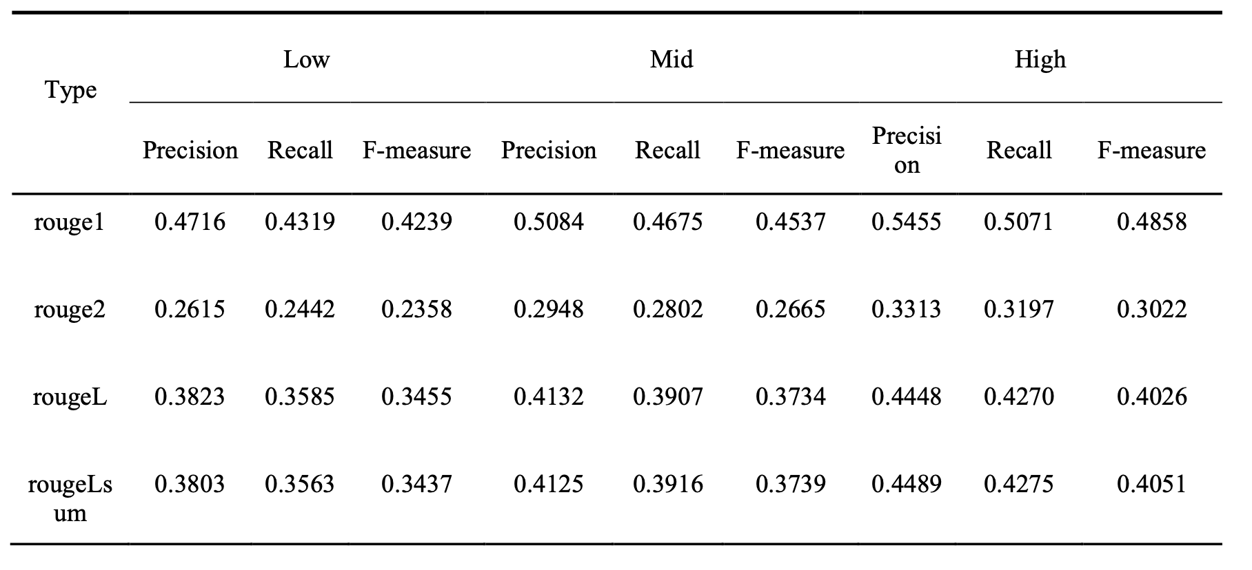
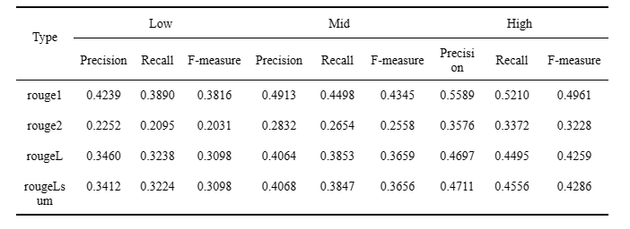
Appendix 5: Findings (cont.)
Performance Comparison
Llama-7b
Llama-13b

Slide 35
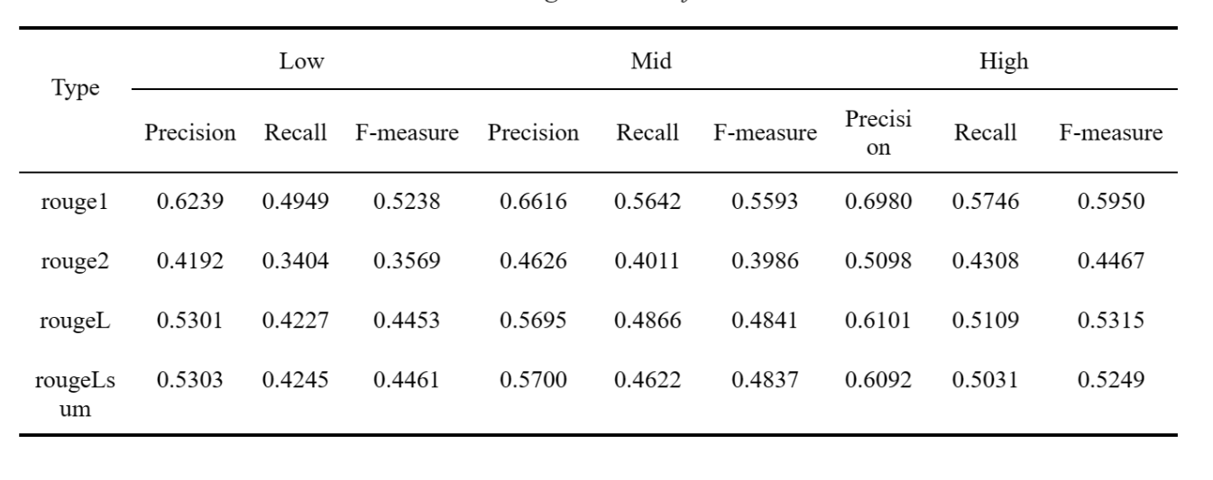
Appendix 5: Findings (cont.)
Performance Comparison
Mistral 7b
Notes:
{'rouge1': AggregateScore(low=Score(precision=0.623949228136091, recall=0.4949101066264214, fmeasure=0.5238280933990552), mid=Score(precision=0.66157308177214, recall=0.5642270422065929, fmeasure=0.5592510940979748), high=Score(precision=0.6979987502367643, recall=0.5745600059887052, fmeasure=0.595009821595101)),
'rouge2': AggregateScore(low=Score(precision=0.419240746990504, recall=0.34035213265003406, fmeasure=0.35688414396120516), mid=Score(precision=0.4625747558794324, recall=0.4011380493577576, fmeasure=0.39863315907977953), high=Score(precision=0.5098378098925307, recall=0.430789547322699, fmeasure=0.44665060340725365)),
'rougeL': AggregateScore(low=Score(precision=0.5300632137134041, recall=0.4227339240565793, fmeasure=0.4453019201737291), mid=Score(precision=0.5694541646442779, recall=0.4866405212001303, fmeasure=0.48414864849695327), high=Score(precision=0.6101184408676096, recall=0.5109223158447603, fmeasure=0.5315195057471779)),
'rougeLsum': AggregateScore(low=Score(precision=0.5302877934958551, recall=0.4245070012162663, fmeasure=0.4461407664587429), mid=Score(precision=0.5699893892546362, recall=0.46217660274190575, fmeasure=0.4837139300798347), high=Score(precision=0.6092498537128651, recall=0.5031140196493458, fmeasure=0.5248604644877153))}

Slide 36
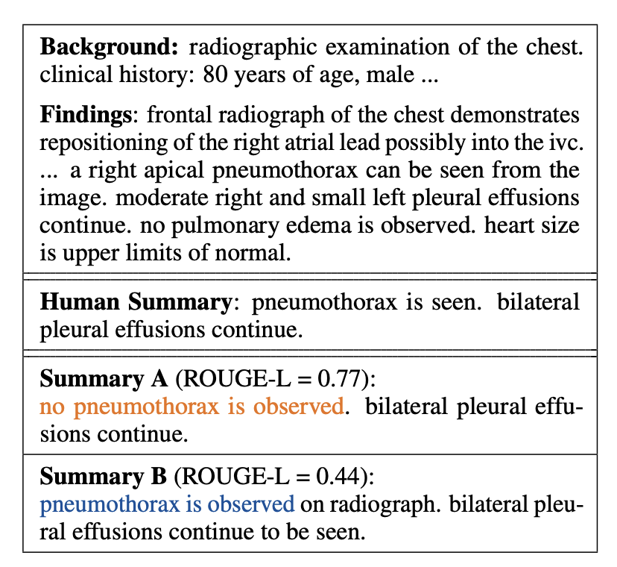
Appendix 6: Factual Correctness
Factual Correctness refers to the ability of these models to generate responses or information that is accurate and true to reality.
Compared to the human summary:
Summary A has high textual overlap (i.e., ROUGE-L) but makes a factual error
Summary B has a lower ROUGE-L score but is factually correct
The factual correctness result of our final Mistral-7b model:
The percentage of negative items is: 13.4%
The percentage of neutral items is: 57.0%
The percentage of positive items is: 27.6%

Slide 37





Appendix 7: Challenges & methods to overcome
1.Train on University of Chicago Medicine data and test on Indiana University data
2.Validation with both statistical language metrics and physician logs
3.Fine-tune for some physician personas and predictions adjusted with patients’ clinical history
4.Develop Proprietary embeddings for different institutions and second attention mechanism for medical language processing
5.Adaptation to various deployment options including cloud and on-prem

Slide 38
Appendix 8: Data bias and ethics discussion
Bias
Definition
In our project:
Historical Bias
Arises even if data is perfectly measured and sampled, reflecting existing societal stereotypes in datasets
The risk of perpetuating historical stereotypes or inaccuracies present in medical data.
Representation Bias
Occurs when the development sample under-represents part of the population, leading to failures in generalization for certain subsets
Occurs when the dataset does not adequately represent the diversity of the patient population
Aggregation Bias
A "one-size-fits-all" approach that overlooks underlying groups or types in the data, potentially leading to a model that is suboptimal for any group or biased towards the dominant population​
The challenge of creating models that are applicable to varied medical scenarios and patient groups without losing specificity
Evaluation Bias
Concerns the quality of the learned function and how it is measured. Addressing this may involve redefining the function that computes evaluation metrics and adjusting the data on which metrics are computed
Risk that the metrics used do not accurately reflect model’s efficacy in real-world medical settings. (e.g. Rouge Score vs.. Factual Correctness)
Solution
Ensure diversity and completeness in data
Implement model validation on different datasets
Engage with healthcare professionals and potentially patients
Continuously monitor and update the model

